Slide 1
Sampling with Halton Points on n-Sphere
Wai-Shing Luk
luk@fudan.edu.cn
(confidential)

Slide 2
Abstract
Sampling on the n-sphere (S^{n}) has a wide range of applications, such as
Spherical coding in MIMO wireless communication
Multivariate empirical mode decomposition
Filter bank design
We propose a simple yet effective method which:
Utilizes low-discrepancy sequence
Contains only 10 lines of MATLAB code in our implementation!
Allow incremental generation.
Numerical results show that the proposed method outperforms the randomly generated sequences and other proposed methods…

Slide 3
Overview
Motivation and applications
Review of Low discrepancy sequence
Van der Corput sequence on [0,1]
Halton sequence on [0,1]^{n}
Halton sequence on sphere (i.e. S²)
Our approach
Numerical Experiments
Conclusions

Slide 4
Introduction

Slide 5
Problem Formulation
Desirable properties of samples over S^{n}: Uniform and Incremental
The uniformity measures are optimized with every new point.
Reason: in some applications, it is unknown how many points are needed to solve the problem in advance

Slide 6
Motivation
The topic has been well studied for sphere in 3D, i.e. n = 2.
Yet it is still unknown how to generate for n > 2.
Potential applications (for n > 2):
Robotic Motion Planning (S³ and SO(3))
Sampling in different rotations.
Spherical coding in MIMO wireless communication:
Cookbook for Unitary matrices
A code word = a point in S^{n}
Multivariate empirical mode decomposition
Other applications???
Notes:
As far as I know, the MIMO system in LTE needs a codebook of unitary matrices in order to perform an SVD-like transformation. A set of all unitary matrices forms a Grassmann manifold. One of the objective of designing a codebook is to maximize the minimum (chordal) distance, so that the codebook can cover the manifold as much as possible.

Slide 7
Halton Sequence
Halton sequence on S² has been well studied [CuiFreeden 97] by using cylindrical coordinates.
Yet it is still unknown for S^{n}

Slide 8
Review of Low discrepancy sequence

Slide 9
Basic: Van der Corput sequence
Generate a low discrepancy sequence over [0, 1]
Denote vd(k,b) as a Van der Corput sequence of k points, where b is the base of a prime number.
Matlab code is available at http://www.mathworks.com/matlabcentral/fileexchange/15354-generate-a-van-der-corput-sequence

Slide 10
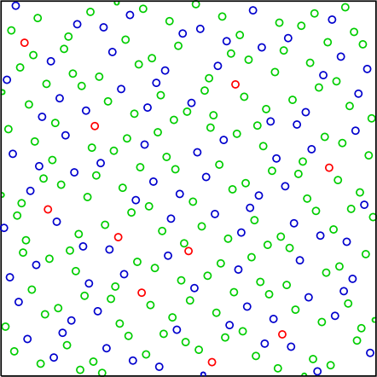
Unit Square [0,1] x [0,1]
Halton sequence: using 2 Van der Corput sequences with different bases. For example:
[x, y] = [vd(k,2), vd(k,3)]

Slide 11
Unit Hypercube [0, 1]^{n}
Generally we can generate Halton sequence in a unit hypercube [0, 1]^{n}
[x₁, x₂, x₃, …, x_{n}] = [vd(k,b₁), vd(k,b₂), … vd(k,b_{n})]
A wide range of applications on Quasi-Monte Carlo Methods (QMC).

Slide 12
Unit Circle S¹
Can be generated by mapping the Van der Corput sequence to [0, 2π]:
θ = 2π * vd(k, b)
[x, y] = [cos(θ), sin(θ)]

Slide 13
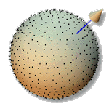
Unit Sphere S²
[z, x, y]
= [cos(θ) , sin(θ) cos(ϕ), sin(θ) sin(ϕ)]
= [z, √(1-z²) cos(ϕ), √(1-z²) sin(ϕ)]
ϕ = 2π * vd(k, b₁) % map to [0, 2π]
z = 2*vd(k, b₂) – 1 % map to [-1, 1]
Has been applied for computer graphic applications [WongLuk 97].

Slide 14
Spheres S^{n} and SO(3)
Random sequences:
To generate random points on S^{n}, spherical symmetry of the multidimensional Gaussian density function can be exploited.
Then the normalized vector (x_{i}/||x_{i}||) is uniformly distributed over the hypersphere S^{n}.
[Fishman, G. F. (1996)]
Deterministic point sets
Optimal discrepancy point sets for S^{n}, SO(3)
[Lubotzky, Phillips, Sarnak 86] [Mitchell 07]
No Halton sequences to our knowledge
Notes:
To generate uniformly distributed random points on a hypersphere Sd, spherical symmetry of the multidimensional Gaussian density function can be exploited (Fishman 1996). Then the normalized vector (xi/||xi||) is uniformly distributed over the hypersphere S^d.
Fishman, G. F. (1996). Monte Carlo: Concepts, Algorithms, and Applications. Berlin, Springer.
Mitchell, J. C. (2007). Sampling rotation groups by successive orthogonal images. SIAM Journal on Scientific Computing, 30(1): 525–547.

Slide 15
Our approach

Slide 16
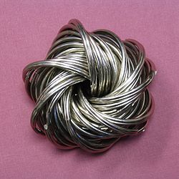
SO(3) or S³ Hopf Coordinates
Spherical coordinates:
x₁ = cos(θ₃)
x₂ = sin(θ₃) cos(θ₂)
x₃ = sin(θ₃) sin(θ₂) cos(θ₁)
x₄ = sin(θ₃) sin(θ₂) sin(θ₁)
Hopf coordinates (cf. Yershova et. al. 2010):
x₁ = cos(θ/2) cos(ψ/2)
x₂ = cos(θ/2) sin(ψ/2)
x₃ = sin(θ/2) cos(ϕ + ψ/2)
x₄ = sin(θ/2) sin(ϕ + ψ/2)
S³ is a principal circle bundle over the S²:

Slide 17
Hopf Coordinates for SO(3) or S³
Similar to the Halton sequence generation on S², we perform the mapping:
ϕ = 2π * vd(k, b₁) % map to [0, 2π]
ψ = 2π * vd(k, b₂) % map to [0, 2π] for SO(3),
or ψ = 4π * vd(k, b₂) % map to [0, 4π] for S³
z = 2*vd(k, b₃) – 1 % map to [-1, 1]
θ = cos⁻¹z

Slide 18
10 Lines of MATLAB code
function[s] = sphere3_hopf(k,b)
% sphere3_hopf Halton sequence
phi = 2*pi*vdcorput(k,b(1)); % map to [0, 2*pi]
psy = 4*pi*vdcorput(k,b(2)); % map to [0, 4*pi]
z = 2*vdcorput(k,b(3)) - 1; % map to [-1, 1]
theta = acos(z);
cos_eta = cos(theta/2);
sin_eta = sin(theta/2);
s = [cos_eta .* cos(psy/2), ...
cos_eta .* sin(psy/2), ...
sin_eta .* cos(phi + psy/2), ...
sin_eta .* sin(phi + psy/2)];

Slide 19
3-sphere
Polar Coordinate:
x₀ = cos(θ₃)
x₁ = sin(θ₃) cos(θ₂)
x₂ = sin(θ₃) sin(θ₂) cos(θ₁)
x₃ = sin(θ₃) sin(θ₂) sin(θ₁)

Slide 20
n-sphere
Polar Coordinate:
x₀ = cos(θ_{n})
x₁ = sin(θ_{n}) cos(θ_{n-1})
x₂ = sin(θ_{n}) sin(θ_{n-1}) cos(θ_{n-2})
x₃ = sin(θ_{n}) sin(θ_{n-1}) sin(θ_{n-2}) cos(θ_{n-3})
…
x_{n-1} = sin(θ_{n}) sin(θ_{n-1}) sin(θ_{n-2})………….cos(θ₁)
x_{n} = sin(θ_{n}) sin(θ_{n-1}) sin(θ_{n-2})………….sin(θ₁)

Slide 21
How to Generate the Point set
p₀ = [cos(θ₁), sin(θ₁)] where θ₁ = 2π * vd(k, b₁)
Let f_{j}(θ) = ∫ sin^{j}(θ) dθ, where θ in (0, π)
Note: f_{j}(θ) is a monotonic increasing fct. in (0, π)
Map vd(k, b_{j}) uniformly to f_{j}(θ):
t_{j} = f_{j}(0) + (f_{j}(π) – f_{j}(0)) * vd(k, b_{j})
Let θ_{j} = f_{j}⁻¹(t_{j})
Define p_{n} recursively as:
p_{n} = [cos(θ_{n}), sin(θ_{n})*p_{n-1}]

Slide 22
10 lines of MATLAB code
function[p] = sphere_n(k, n, b)
% n-sphere
x0 = (2*pi)*vdcorput(k, b(1)); % map to [0, 2*pi]
p = [cos(x0), sin(x0)];
x = [0:pi/(3*k -1):pi];
for i=1:n-1
syms a;
t = subs(int(sin(a)^i), x);
ti = t(1) + (t(m) - t(1)) * vdcorput(k, b(i+1)); % map to [t1, tm]
xi = interp1(t,x,ti,'spline');
p = [cos(xi), sin(xi)*ones(1,i+1) .* p];
end

Slide 23
Result of sphere_n(20,3,[2 3 5])
1.0000 0 0 0
0.4919 -0.2902 -0.8209 0.0000
0.1577 0.3292 0.0000 0.9310
-0.1577 -0.7680 -0.0000 -0.6207
-0.4919 -0.0967 0.6118 0.6118
0.8328 0.3076 -0.3255 -0.3255
0.4212 -0.5039 -0.5332 0.5332
0.0944 0.1106 0.6996 -0.6996
-0.2217 0.7584 0.5662 0.2345
-0.5659 -0.7634 -0.2877 -0.1192
0.7316 -0.1767 -0.2520 0.6083
0.3531 0.3812 0.3270 -0.7894
0.0314 -0.7034 0.2718 0.6561
-0.2867 -0.0355 -0.3664 -0.8845
-0.6449 0.4812 -0.5485 0.2272
0.6449 -0.3680 0.6188 -0.2563
0.2867 0.1774 0.9234 0.1837
-0.0314 0.8514 -0.5135 -0.1021
-0.3531 -0.7970 -0.0956 0.4806
-0.7316 -0.1262 0.1307 -0.6570
0.5659 0.3970 0.4015 0.6008
It took < 0.1 sec. to generate in MATLAB.

Slide 24
Testing the Correctness
Compare the dispersion with the random point-set.
Construct the convex hull for each point-set.
Dispersion roughly measured by the determinant of the largest facet:
max |det([1, p₁– p₀, p₂– p₀, … p_{n}– p₀,])|
Better idea???
Notes:
To generate uniformly distributed random points on a hypersphere Sd, spherical symmetry of the multidimensional Gaussian density function can be exploited (Fishman 1996). Then the normalized vector (xi/||xi||) is uniformly distributed over the hypersphere S^d.
Fishman, G. F. (1996). Monte Carlo: Concepts, Algorithms,
and Applications. Berlin, Springer.

Slide 25
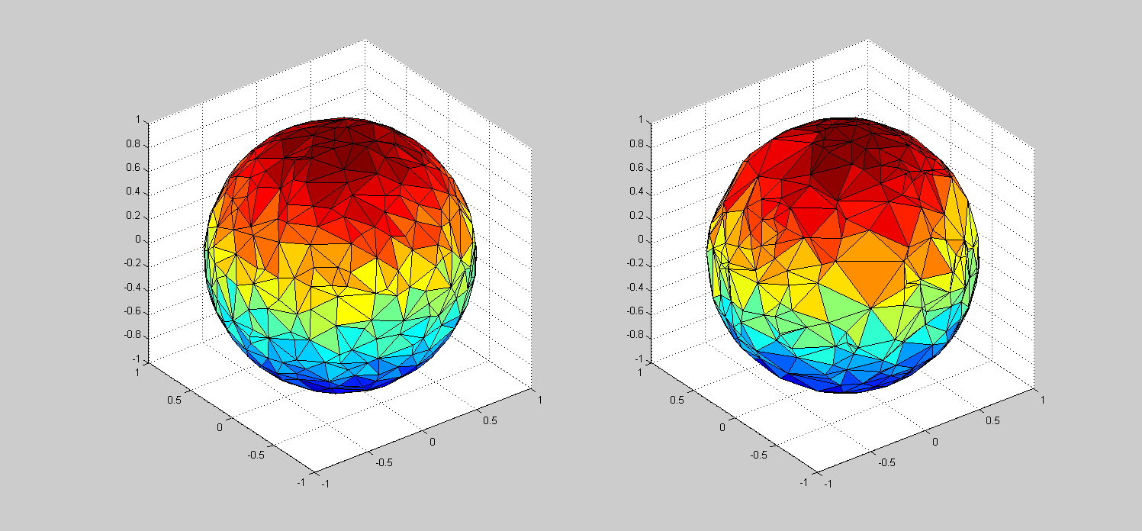
Convex Hull with ~400 3D points
Low discrepancy point-set
Random point-set

Slide 26
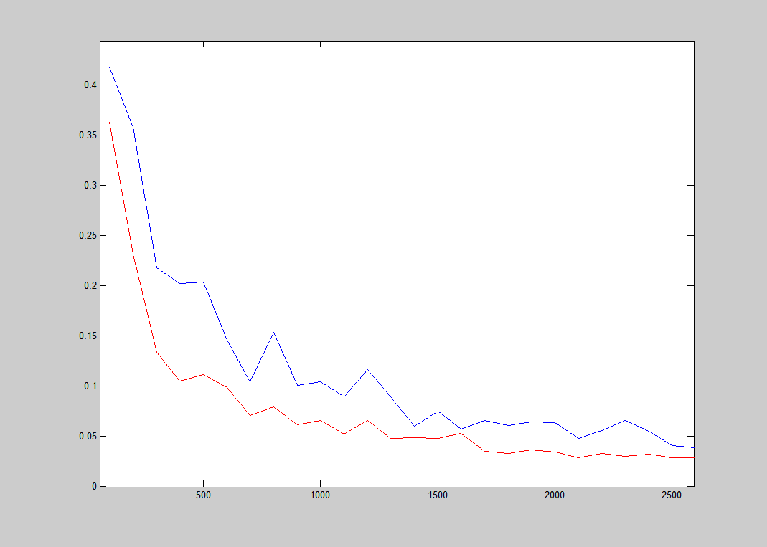
n=2
Red line: our, blue line: rand

Slide 27
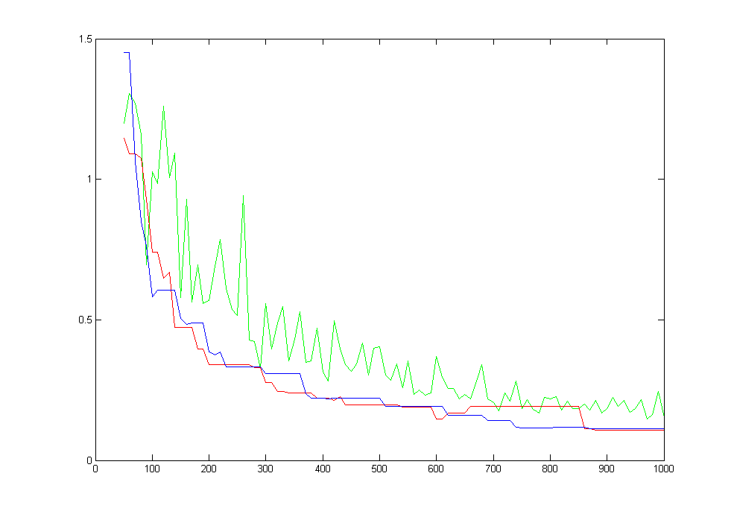
n=3
red line: our, blue line: Hopf, green line: rand

Slide 28
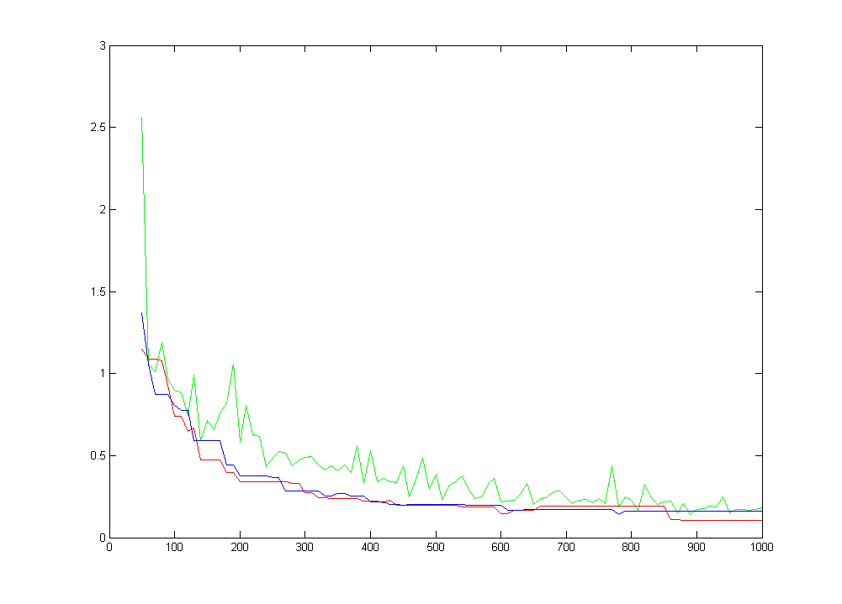
n=4
red line: our, blue line: cylin, green line: rand

Slide 29
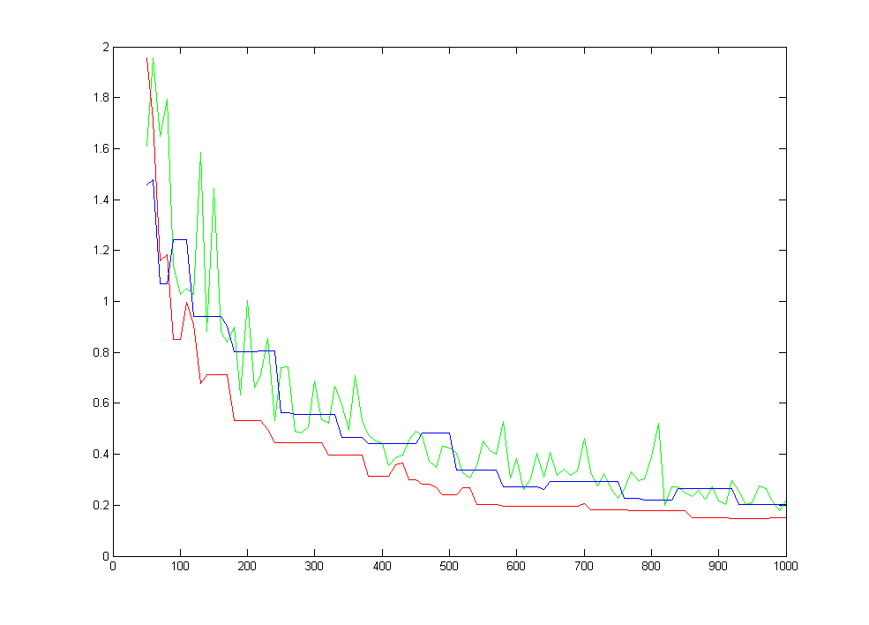
n=5
red line: our, blue line: cylin, green line: rand

Slide 30
Conclusion
Proposed method generates low-discrepancy point-set in nearly linear time.
The result outperforms the corresponding random point-set, especially when the number of points is small.
The MATLAB source code is available in public later, or upon request.

